Slide 1

Spotify AI – Powered Music Recommendation System
Project Scope & Organizational Culture
The Blue Team

Slide 2
Meeting Agenda
Project Scope Statement
Project Priority Matrix
Organizational Culture Analysis
Impact of Culture on Project Scope and Priorities
Q & A

Slide 3
Project Objective
Develop an AI-powered music recommendation system to enhance user engagement and maintain Spotify’s competitive edge
Product Scope Description
Features and Functions
High-accuracy recommendation algorithm (90%)
Seamless integration with Spotify’s user interface and backend
Compliance with GDPR and CCPA
Enhanced user experience through hyper-personalized music suggestions
Justification
Address the challenge of personalizing user experience in a competitive market
Increase user satisfaction, retention, and revenue growth
Project Scope Statement

Slide 4
Deliverable 1
Deliverable 2
Deliverable 3
AI Recommendation Algorithm
Compliance Reports for GDPR/CCPA
Cloud Infrastructure Setup
for data storage and analytics
OUTCOME
Deliverables & Milestones
Milestone 1
Milestone 2
AI Algorithm Prototype Completion (Month 2)
Deliverables & Milestones
System Integration Start (Month 4)
Milestone 3
Milestone 4
Milestone 5
Beta Testing & Feedback Collection (Month 6)
Full System Deployment (Month 8)
Final Project Wrap-Up (Month 9)

Slide 5
9 Months
GDPR & CCPA
Compliance
Timeline, Budget & Compliance
Requirements
Timeline
Must be completed within 9 months to meet business goals
Adherence to GDPR and CCPA data privacy regulations is mandatory throughout the project
$150M
Allocated project budget
Constraints
Key Limitations
Limited to $150 million for development, integration, and deployment

Slide 6
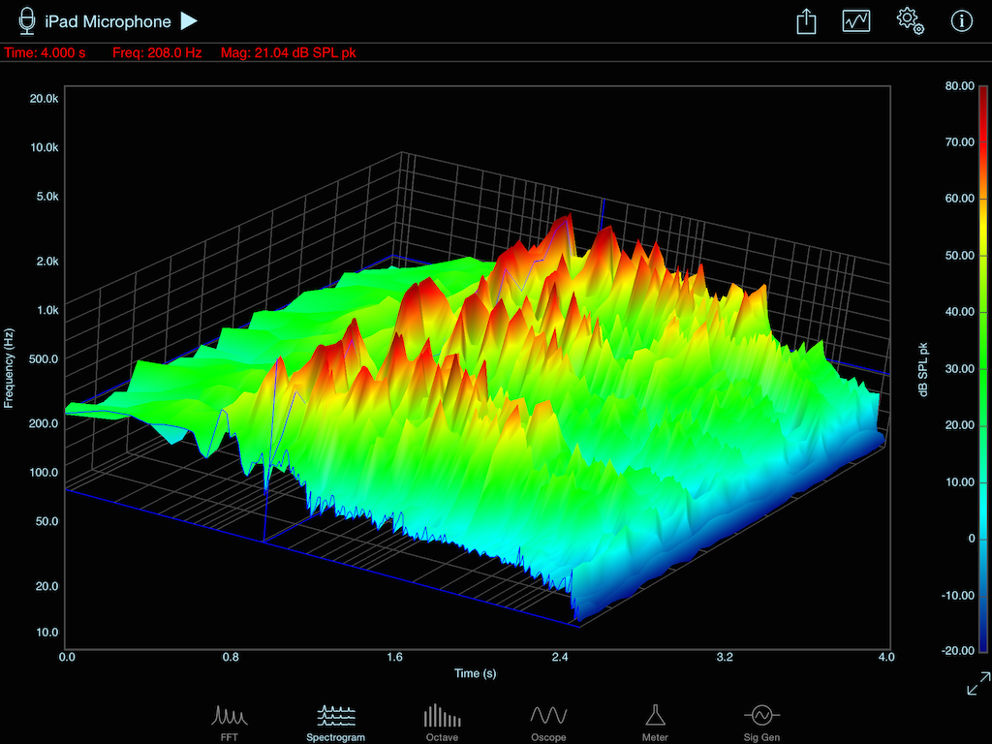
Advanced AI/ML Algorithm
Deep Learning Neural Models for sequential data modeling to capture complex patterns in user preferences and music features.
CNN (Convolutional Neural Networks)
Used for processing grid-like data by analyzing spectrograms (visual representation of sound waves) to understand audio characteristics like timbre, rhythm, genre.
Functions
Technical
Requirements
Audio Classification: CNNS can be used to classify sounds, music, or instruments by analyzing spectrograms derived from audio signals.
Music Genre Recognition: CNNS are employed to categorize music into different genres based on features extracted from the audio - more than just providing metadata.

Slide 7
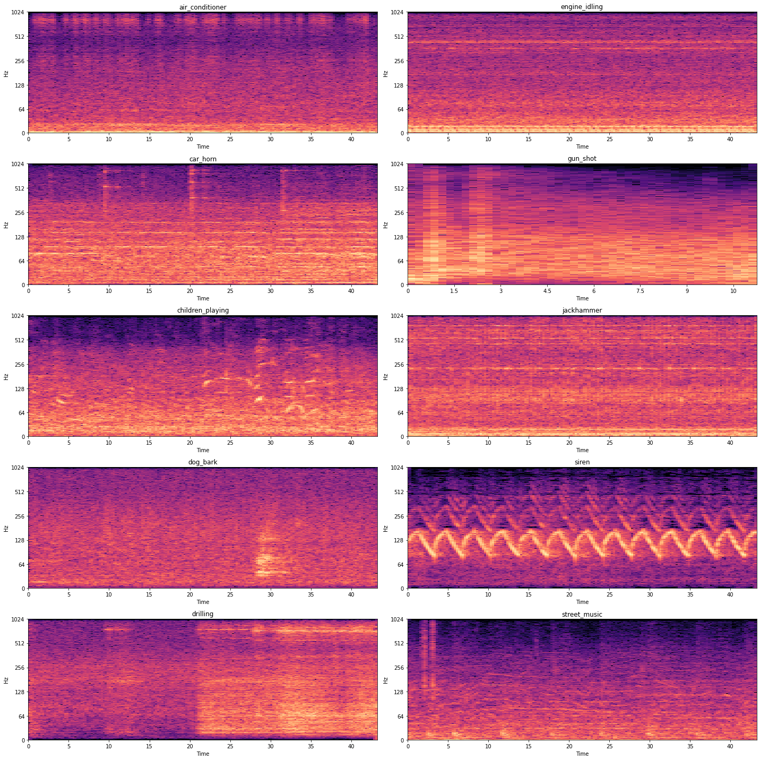
Technical
Requirements
CNN Output

Slide 8
RNN (Recurring Neural Network)
Used for processing sequential data and ideal for time series analysis - when the data order matters..
Functions
Technical
Requirements
Track user behavior: Learns patterns such as when the user listens to music (morning or night), how often, what kind of songs they prefer after certain activities.
Identify trends: Over time, it can predict what kind of music a user will likely enjoy at different moments.

Slide 9
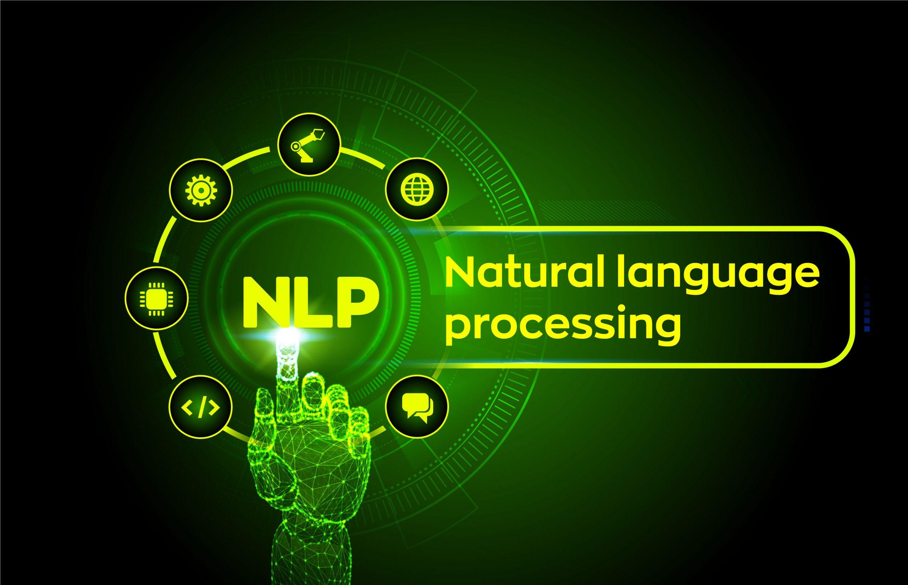
NLP (Natural Language Processing)
Focused on the interaction between computers and human language, enabling machines to understand, interpret, and generate text.
Functions
Technical
Requirements
Sentiment Analysis: Analyze song lyrics for themes, sentiments, or topics enriching the understanding of a song's emotional context tagging tracks with moods and grouping .
Text Classification: analyzing lyrical content and recommending similar artists/tracks and enrich discovery experience.
Contextual recommendations: based on current events, holidays or seasons along with user behaviour.

Slide 10
Recommendation Algorithms
Focused on the interaction between Collaborative filtering: Based on user behavior, such as similar listeners and common patterns.
Content-based filtering: Based on the actual content (audio features, lyrics) of songs that the user has listened to.
Hybrid models: Combine multiple approaches, such as content-based filtering using CNN features and collaborative filtering using RNNs, for a more personalized recommendation system.
Technical
Requirements

Slide 11
Workflow
=> CNN to classify genre or style of a song by analyzing audio features
=> RNN to analyze the user listening history over time and identify patterns in when and how frequently they listen to certain genres or artists
=> NLP to extract emotional content from lyrics and match with similar tracks
=> A combination of collaborative and content-based filtering supported by deep learning models (CNN, RNN, NLP) would ensure accurate and personalized recommendations.
=> Multi-faceted approach to give Spotify a robust system for making precise recommendations tailored to a user’s preferences, behavior, and even emotional state.
Technical
Requirements

Slide 12

UI Integration
=> API Utilization: Work with Spotify's existing API to access user data, track metadata, and integrate recommendations seamlessly into the UI.
=> Microservices Architecture: Develop the system as a microservice to allow for independent scaling and deployment without disrupting other services.
=> Data Pipeline: Create a data pipeline to ensure the system can pull data from Spotify data warehouses, for real-time processing.
=> Monitoring and Logging: Implement monitoring tools to track performance and integration with Spotify ecosystem.
Technical
Requirements

Slide 13
Compliance with Data Piracy Regulations
=> Data Minimization: Only collect necessary data for effective recommendations and ensure user consent for data usage.
=> Anonymization & Aggregation: Use techniques to anonymize user data and aggregate information to protect individual privacy while still effectively modeling.
=> Regulatory Compliance: Familiarize with regulations, work with Legal teams and ensure that all data handling practices align with GDPR/CCPA laws.
=> Transparency: Clearly communicate with users how their data is being used for recommendations and provide settings for adjusting privacy preferences.
Technical
Requirements

Slide 14
No Development of Non-Music Content
The project will focus solely on music recommendations. Development related to podcasts, videos, or other non-music content will not be included.
Reason: Non-music content would require a different recommendation algorithm and data set, which would expand the scope significantly and introduce delays.
2. No Redesign of the Spotify User Interface (UI)
The project will not include any changes to Spotify's existing user interface beyond the integration of the AI recommendation system.
Reason: UI redesign would require additional resources and testing, distracting from the primary goal of improving the recommendation algorithm.
Limits
&
Exclusions

Slide 15
3. No Changes to Existing Cloud Infrastructure (Unrelated to the Recommendation System)
The project will utilize Spotify’s existing cloud infrastructure only to the extent necessary for the integration and operation of the recommendation system.
Reason: Changes to the cloud infrastructure not directly tied to the recommendation system (e.g., hosting, storage) would involve significant IT resources and could introduce project delays.
4. No External App Integrations
The project will not involve the integration of the AI recommendation system with external apps or services.
Reason: This would add complexity to the development process and require additional testing, pushing the project beyond the intended scope.
Limits
&
Exclusions

Slide 16
5. No Marketing or User Acquisition Activities
The project scope does not include any marketing activities or strategies to promote the AI recommendation system or acquire new users.
Reason: Marketing and user acquisition are separate initiatives handled by Spotify’s marketing department and are not related to the technical development of the system.
6. No Support for Long-Term System Improvements (Beyond Initial Deployment)
The project will not provide ongoing support for feature updates, system maintenance, or future improvements beyond the initial launch.
Reason: Ongoing system improvements will be part of a future phase, with a separate budget and timeline.
Limits
&
Exclusions

Slide 17


SCOPE OF WORK
In Scope
Data Privacy Compliance
Ensuring compliance with global data privacy regulations (GDPR, CCPA)​
Algorithm Refinement
Utilize user data to refine recommendation algorithms
Integration with User Data
Integration with user profiles, listening behavior, and cloud infrastructure
Testing & Validation
Conduct testing phases to validate the accuracy of recommendation system​
03
04
The features and services that the project will deliver
05
02
AI System Development
Development and deployment of the AI recommendation system​
UI Integration
Ensure the recommendation system is seamlessly integrated into user interface​
01
06

Slide 18

Excluded Features and Activities
SCOPE OF WORK
Out of Scope
Excluded Activities and Features
Non-music content development (podcasts, video content)​
Redesign of existing features (interface or overall app design)​
New music licensing or content acquisition (no changes in existing licensing agreements)​
Changes to cloud infrastructure not related to the recommendation system​
Integration with external apps not directly related to the recommendation system​
Activities related to the marketing of the new system or acquiring new users​
Support for long-term system improvements beyond the project’s initial scope​

Slide 19
SCOPE CREEP
Scope Creep – Potential Sources & Mitigation Plans
1. Expansion to Non-Music Content
There could be pressure to extend the AI recommendation system to podcasts or videos, adding complexity
beyond the project's music focus.
Mitigation: Use strict scope control with a well-defined scope document and require formal sign-offs for any changes. Regularly communicate the project’s focus on music.
2. Changes in Data Privacy Laws
New or evolving regulations like GDPR/CCPA may require additional work to comply, affecting timelines and resource allocation.
Mitigation: Engage legal and data privacy teams early and throughout the project, with regular compliance reviews to adapt quickly to new regulations.

Slide 20
SCOPE CREEP
Scope Creep – Potential Sources & Mitigation Plans
3. Unexpected Integration Challenges
Integrating the AI system with Spotify’s platform could encounter technical difficulties, such as compatibility issues or system disruption.
Mitigation: Use phased integration with early testing to identify issues and resolve them incrementally. Cross-functional teams will collaborate closely to handle integration efficiently.
4. Feature Creep Due to User Feedback
Beta testers or stakeholders may request additional features or changes, such as more customization options, leading to scope expansion.
Mitigation: Limit feedback scope to critical issues for this phase and defer non-essential requests to future project phases. Communicate clear boundaries on feature requests.

Slide 21
Priorities Matrix
& PM Triangle
Scope
Quality
Cost (Constrained): Fixed budget of $150M; cannot exceed this limit.
Time (Enhanced): Deliver within 9 months, but minor extensions are acceptable if they significantly improve the outcome.
Scope (Accepted): Core functionality is essential, but minor adjustments to features can be tolerated to meet budget or time constraints.
Cost
Time
 | Cost | Time | Scope
Constrain
Enhance
Accept

Slide 22
01
Internal
Project Sponsor
AI/ML Team
Data Privacy & Legal Team
Key Stakeholders
02
External
Cloud Storage Partners​
Analytics Providers​
Regulatory Bodies (for compliance)​

Slide 23

HIGH LEVEL PLAN
Timeline
Month 1
Project Initiation, planning & Kick-off
Month 2
AI
Algorithm
Prototype Completion
Month 4
System Integration
Month 6
Beta Testing
& User Feedback
Month 8
Full System Deployment
Month 9
Project Wrap up & Compliance Certification

Slide 24
Key Stakeholders (Internal /External)
Name | Role | Title | Department
Tony Jabara | Project Sponsor, providing strategic oversight and resource allocation | Head of AI and Machine Learning | AI and Machine Learning
Ruchika Singh | Develop and optimize the recommendation algorithm. | Algorithm Optimization Specialist. | Data Science and Analytics
Ashley Lott | Review and address legal concerns related to data handling and privacy. | Legal Advisor | Legal
Gustav Söderström | Oversee the integration of the AI system with Spotify’s existing platform | Product Integration Specialist | Product
Brandon Bauman | Coordinate with external partners for cloud storage and analytics needs | Cloud Storage and Analytics Liaison | IT/Cloud Operations

Slide 25

Name | Title | Role
Sally Zreiqat | Program Manager | Overall responsibility for the project, overseeing multiple project managers and ensuring alignment with strategic goals.
Daniel Demetrios | Technical Project Manager | Focused on the development and implementation of algorithms, ensuring technical requirements are met.
Walter Giron | Implementation Manager | Responsible for overseeing the execution phase, ensuring that project deliverables are implemented effectively and on schedule.
Xaver Colin | Quality Assurance Manager | Ensures that all project outputs meet quality standards, conducting reviews and tests throughout the project lifecycle
Ozorio Delfin | Stakeholder Engagement Manager | Manages communication and relationships with stakeholders, ensuring their needs and feedback are addressed.
Borole Atharva Vikas | Resource Manager | Oversees the allocation of resources across various teams, optimizing usage and addressing any resource-related issues.
Project Management
Office
Team Structure

Slide 26
HIGH LEVEL RISKS
Risk Management – Part I
Algorithm Accuracy Risk: The AI recommendation algorithm may not achieve the targeted 90% accuracy.
Mitigation: Conduct iterative testing and model refinement, leveraging Spotify’s machine-learning expertise.
Integration Risk: Integration of the AI system may disrupt existing services on Spotify's platform.
Mitigation: Perform phased integration with extensive internal testing before full rollout.
Ethical and Bias Risk: The AI may display biased recommendations, impacting user satisfaction and fairness.
Mitigation: Implement bias detection and correction techniques, regularly audit the algorithm, and ensure diverse datasets.
Technical Risk: Technical failures or bottlenecks may occur during AI model development or integration.
Mitigation: Utilize cloud-based infrastructure for scalability and redundancy and have dedicated technical support teams.
Compliance & Legal Risk: Failure to meet GDPR/CCPA compliance requirements could result in legal and financial penalties.
Mitigation: Involve legal and data privacy teams early in the process and obtain compliance certification before deployment.
Operational Risk: Cross-functional collaboration issues may delay development.
Mitigation: Assign a dedicated project manager and hold regular cross-functional meetings to ensure alignment.

Slide 27
HIGH LEVEL RISKS
Risk Management – Part II
User Perception Risk: Some may feel uncomfortable with AI-generated recommendations, believing their privacy is being compromised.
Mitigation: Clearly communicate how the AI system works, ensure transparency around data usage, and provide users with options to control their data and preferences.
Contractual Risk: Issues with external partners (e.g., cloud services) may lead to delays or financial penalties.
Mitigation: Establish clear SLAs with external vendors and monitor their performance closely.
Reputation and User Trust Risk: Misuse of user data or poor recommendations could erode user trust in Spotify’s platform.
Mitigation: Ensure transparency in data usage, prioritize privacy, and maintain high-quality recommendations.

Slide 28
OUR STRATEGY
Stakeholder Engagement Strategy
During Kickoff
Pre-Kickoff
Post Kickoff
Brief key stakeholders and gather feedback on the project charter
Clarify roles, encourage active participation, and align expectations
Establish regular check-ins and a feedback loop to maintain ongoing alignment and resolve issues

Slide 29
OUR STRATEGY
Communication Strategy
Bi-weekly reports: Review progress updates, risks, budget tracking.
Monthly 30-minute meetings 1st Tuesday of every month: Review milestones and strategic concerns.
Method: Email reports and video/in-person meetings.
Weekly meetings every Wednesday: Track progress and discuss blockers.
Daily standups: Quick updates on tasks and issues.
Ad-hoc meetings: As needed.
Method: Teams for informal discussions, video conferencing. for formal meetings.
1
Executive Sponsor (Head of AI/ML)
2
Project Team Members (AI/ML, Legal, Data Privacy, Product)
3
Stakeholders (Product, Legal, Marketing, External Partners)
Monthly updates: Summarize progress and risks.
Quarterly reviews: Comprehensive status, adjust plans.
Method: Email updates, video/in-person reviews.
4
Project Documentation
Weekly status reports: Progress, risks, next steps (Jira).
Risk/issue logs: Regular updates, shared with the team and sponsor.

Slide 30




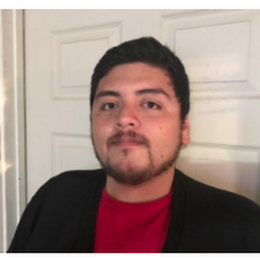





Organizational Chart
Daniel EK
CEO and Chairman
Project Management Office (PMO)
Leadership Team
Sally, Zreiqat
(PMO)Project Manager
Gustav Söderström
Chief R&D Officer At Spotify
Xavier Colin
(PMO)Quality Assurance Manager
Walter R Giron
(PMO)Implementation Manager
Alex Norstrom
Chief Freemium Business Officer
Katarina Berg
Chief Freemium Business Officer
Borole Athrava Vikas
(PMO)Quality Resource Manager
Demetrios Daniel
(PMO)Technical Project Manger
Daniel Ozorio Delfin
(PMO)Stakeholder Engagement Manager

Slide 31
OUR CULTURE
Our Culture – Key Characteristics
Spotify's organizational culture plays a significant role in driving its innovation, creativity, and growth in the competitive music streaming market.
1. Innovation and Experimentation
2.Data-Driven Decision Making
3. Diversity and Inclusion
Culture of Innovation: Encourages continuous innovation and experimentation, fostering a "fail-fast" mentality.
Cross-Functional Collaboration: Agile teams collaborate closely, rapidly implementing user feedback.
Data-Centric Mindset: Decisions are shaped by data across all levels, especially in recommendations and product development.
AI and Machine Learning: AI/ML is used to personalize user experiences and guide business strategies.
Global Workforce: Promotes diversity, enhancing creativity and problem-solving through various perspectives.
Inclusive Products: Personalized experiences cater to a global, diverse audience.

Slide 32
OUR CULTURE
Our Culture – Key Characteristics
4. Work-Life Balance and Employee Well-being
5. Creative Freedom and Empowerment
6. Customer-Centricity
Flexible Work Environment: Remote work and focus on balance improve well-being and productivity.
Employee Empowerment: Autonomy allows employees to lead projects and make decisions, boosting motivation.
Freedom to Innovate: Employees are encouraged to take risks and explore new ideas.
Open Feedback Culture: Continuous improvement is encouraged through transparent feedback.
User Experience Focus: Decisions center on delivering a great user experience, refining products based on feedback.
Personalization: Focus on tailoring the platform to individual user preferences.

Slide 33
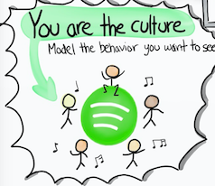
OUR CULTURE
Our Culture – Key Characteristics
Our Culture emphasizes innovation, data-driven decisions, diversity, emphasizes innovation, data-driven decisions, diversity, and employee empowerment.
This fosters collaboration, creativity, and a user-centric focus, encouraging independent thinking, experimentation, and personal and professional growth.

Slide 34
OUR CULTURE
Our Culture – A Closer Look
Let's dive deeper into Spotify's unique culture
The Culture
Cultural Dimensions Present
Physical Characteristics: Open offices and collaborative spaces promote innovation and communication.
Public Documents: Transparent reports highlight innovation and user experience.
Behavior: Emphasis on data-driven decisions, risk-taking, and cross-functional teamwork.
Folklore: Agile development (squads, tribes, and guilds) fosters collaboration and autonomy.
Member Identity: Individual contributions are key to team success.
Group Emphasis: Collaboration across teams is essential.
Risk Tolerance: High tolerance for innovation and experimentation in AI/ML.
Reward Criteria: Performance and project success are rewarded.
Open-Systems Focus: Embraces external partnerships for project support.

Slide 35
OUR CULTURE
Our Culture – A Closer Look
Let's dive deeper into Spotify's unique culture
Impact on Project Scope and Priorities
Impact on Project Management
Supportive: Collaboration and autonomy drive progress, with agile practices aligning well with AI development.
Challenges: Temporary assignments and shifting resources may pose challenges, but the flexible culture enables adaptation.
Scope: The innovative, risk-tolerant culture supports ambitious goals but may lead to scope creep if not managed carefully.
Priorities: A focus on user experience might prioritize performance and scope, potentially impacting budget and timelines.

Slide 36
OUR CULTURE
Our Culture – The Dimensions
Key Dimensions
Member Identity: Organization | Risk Tolerance: High
Team Emphasis: Group | Reward Criteria: Performance
Management Focus: Task | Conflict Tolerance: High
Unit Integration: Interdependent | Means-Ends Orientation: Ends
Control: Tight | Open-System Focus: External

Slide 37
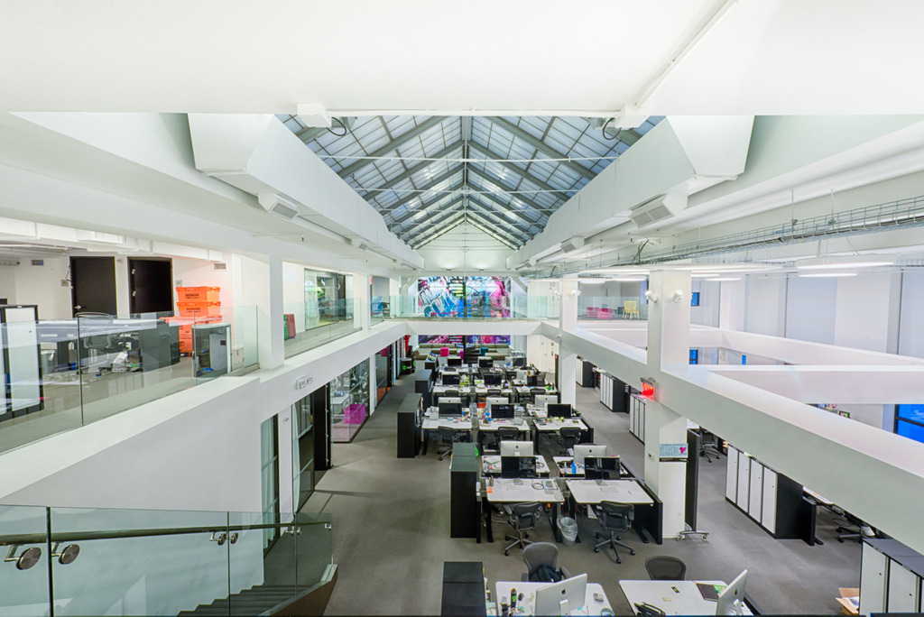
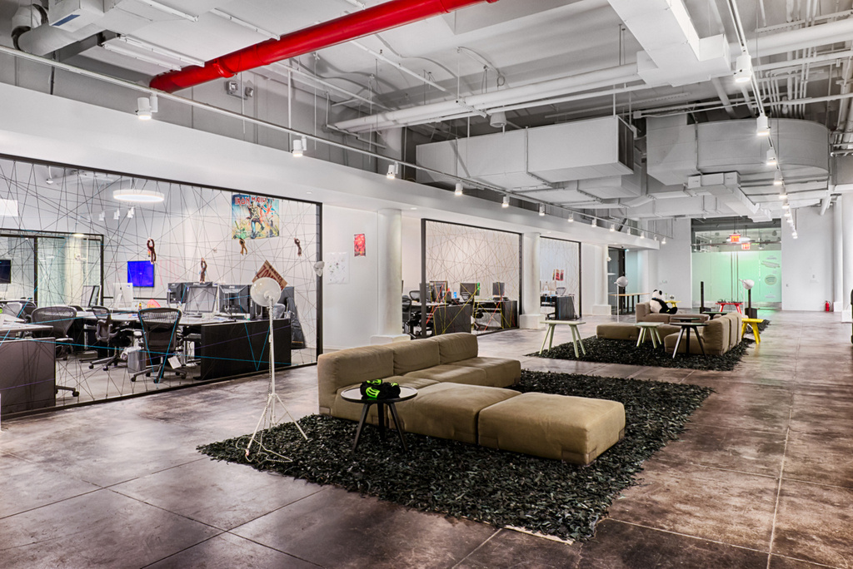
OUR CULTURE
More on Our Culture - Our Offices

Slide 38
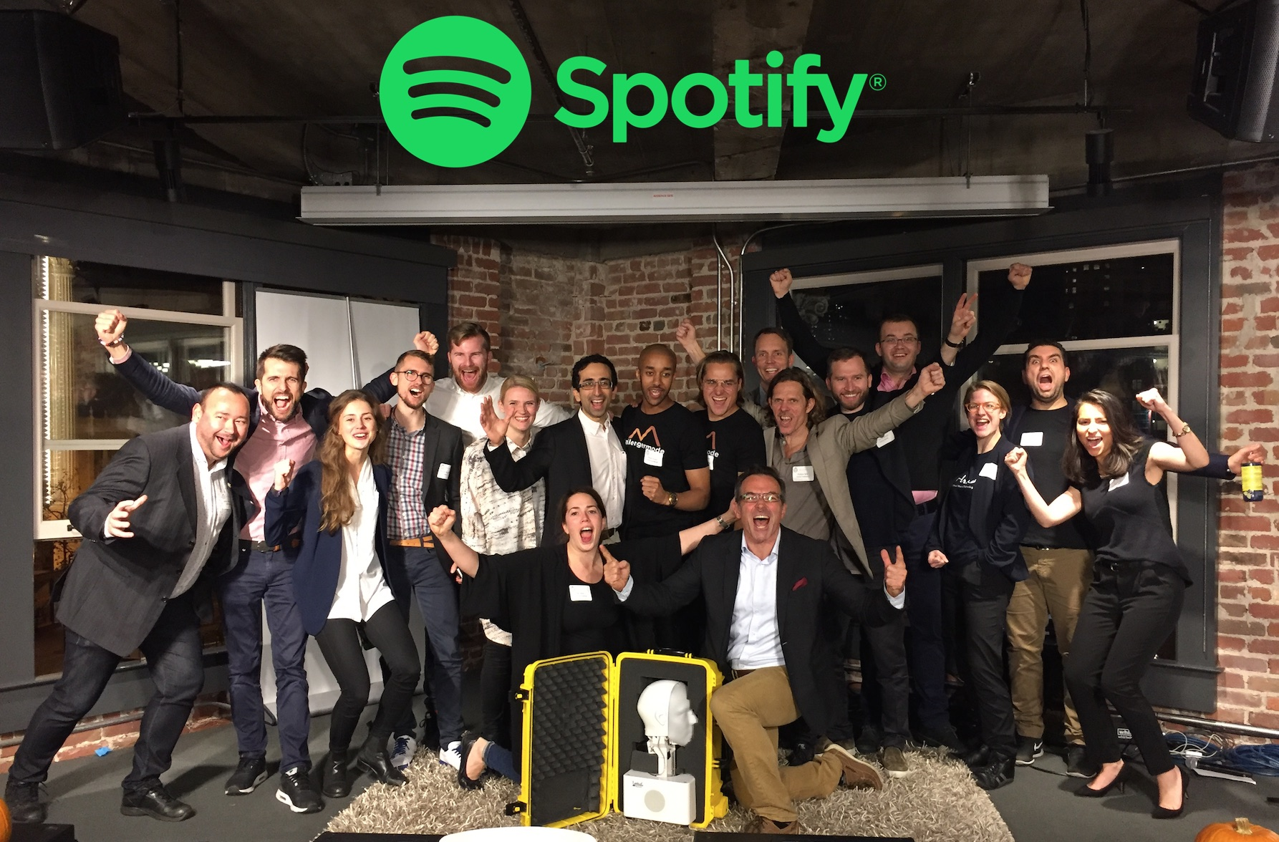
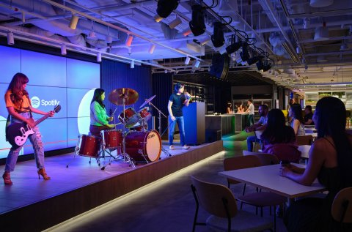
OUR CULTURE
More on Our Culture – The Vibes

Slide 39
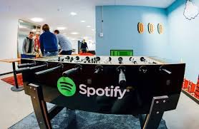

OUR CULTURE
More on Our Culture – Fav. Spots

Slide 40
OUR CULTURE
Driven by
Vision
"To unlock the potential of human creativity by giving a million creative artists the opportunity to live off their art and billions of fans the opportunity to enjoy and be inspired by it."
Mission​
"To provide the world’s best platform for artists, creators, and listeners, driven by data and technology, to deliver a personalized experience for every user."

Slide 41
Link to Project Charter:
Project Charter

Slide 42
Q & A

Slide 43
Thank You!

